Slide 1

Low-fi
Prototype & Evaluation
Larry the Porcupine
Healthcare and Insurance Education
Sean Chang, Melinda Wang, Grace Zhao,
Vrinda Vasavada & Ari Qayumi
Notes:
Intro
Hey everyone!
This is our low-fi prototype & evaluation.
We are Larry the Porcupine.
We focus on healthcare and insurance.
And we are for people who have a prickly problem and need to go to someone to get help with it.
--
FINAL ORDER SLIDES
Story board ideas
Overview of participants
For each tasks do story board for each flow
Presentation Guidelines
Here are the materials you should include in your slides or in the appendix:
Title (2 slides)
Each team member’s name and picture (first name plus last initial) (1 slide)
Introduction (1-2 slides)
Mission Statement/Value Proposition
Problem/Solution Overview
Sketches (images w/ caption) (1 slide showing variety)
Overview image of the 15-20 sketches you made (include all in appendix)
Top 2 designs storyboarded in more detail and the reasoning for choosing these
Tasks and Selected Interface Design (3-4 slides)
3 Tasks
Storyboards for 3 tasks
Reasoning for selection (pros/cons for each)
Prototype description, with images of each screen used by your tasks and a picture of the entire system (include in appendix)
Experiment (3-6 slides)
Method
Participants: demographics, how recruited/compensated
Tasks
Procedure (including environment & testing setup)
Results
Key things you learned for your project going forward
Other supporting material (appendix)
Include raw data (cleaned up and readable)
Include any extra figures or sketches that don’t fit in above
Grading Criteria (Group Grade)
Concept and UI Sketches
Completeness of exploration 10 pts
Selected interface design
Why did you choose it?
Any reasoning from data or constraints of the target platform?
What can you do with it? 20 pts
Representative tasks & task flows
Did the three tasks provide coverage of the functionality in the application? Was it clear on how a user carried out the task? 20 pts
Low-fi prototype
Was the interface appropriate for the supported tasks? Did it follow from sound reasoning? Were appropriate low-fi techniques/style used? 20 pts
Experiment
Was the experiment carried out in a sound manner (e.g., participants, location, method)? Were the results given in sufficient detail to understand what occurred? 20 pts
Quality and clarity of slides 10 pts
Creativity in presentation (extra credit) 10 pts
Grading Criteria (Individual Presenter Grade)
Quality and clarity of slides
Ensure that the presentation shows appropriate preparation, and that visual aids are aesthetic, effective, prepared, and properly employed. Make sure that people at the back of the room can read your slides 25 pts
Cover the required scope within the 8 minute time period
Practice and time your presentation in advance as we will cut you off if you go over. 25 pts
Makes eye contact with the audience 25 pts
Projects voice well 25 pts

Slide 2



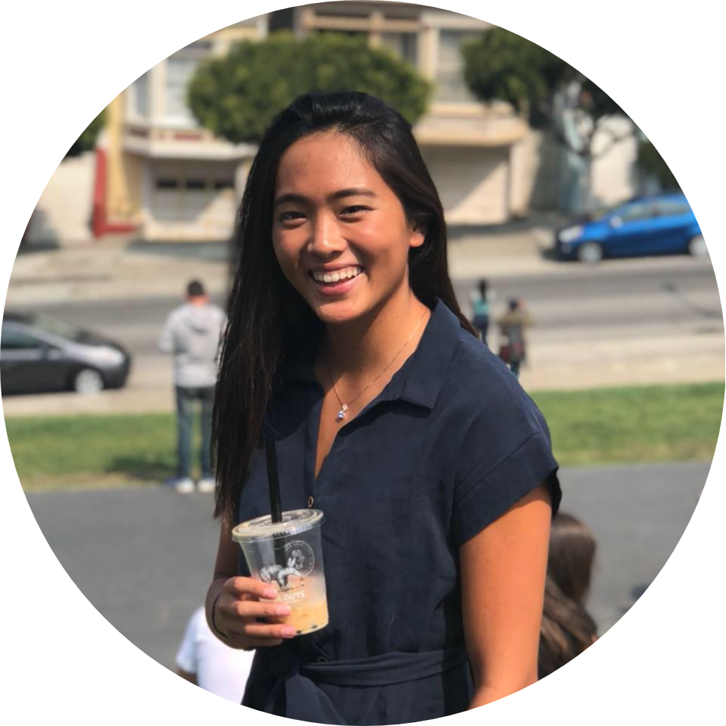

Team Larry!
Sean C.
Melinda W.
Vrinda V.
Grace Z.
Ari Q.
Notes:
For our team, we have a phenomenal set of designers, engineers, and most importantly people who all care about wellness and education.

Slide 3
Problem Domain
Young adults need
higher quality and
better access to healthcare and
health insurance education.
Notes:
As discussed in previous presentations, our team’s initial research found that
Young adults need higher quality and better access to healthcare and health insurance education.
In particular, we found that health insurance education is a leading barrier to better healthcare education.
As a result, we tested these partos of our past interactions and ultimately moved forward with one design.

Slide 4
Mission Statement
To teach young adults (YAs)
how to navigate their lifelong healthcare journeys and foster a culture of preventative care
Notes:
As discussed in previous presentations, our team’s initial research found that
Young adults need higher quality and better access to healthcare and health insurance education.
In particular, we found that health insurance education is a leading barrier to better healthcare education.
As a result, we tested these partos of our past interactions and ultimately moved forward with one design.

Slide 5
Outline
✏️ Sketches
📌 Design Selection
📝 Task Storyboards
📐 Low-fi Prototype
🧪 Experiment
💡 Key Learnings
Appendix
Notes:
Today we will be going over our sketches, design selection process,
task storyboards, low-fi prototypes, experiment, key learnings,
and then take any questions you might have
as well as go over any additional materials in the appendix.

Slide 6
Outline
✏️ Sketches
📌 Design Selection
📝 Task Storyboards
📐 Low-fi Prototype
🧪 Experiment
💡 Key Learnings
Appendix
Notes:
First let’s dive into our initial sketches.

Slide 7
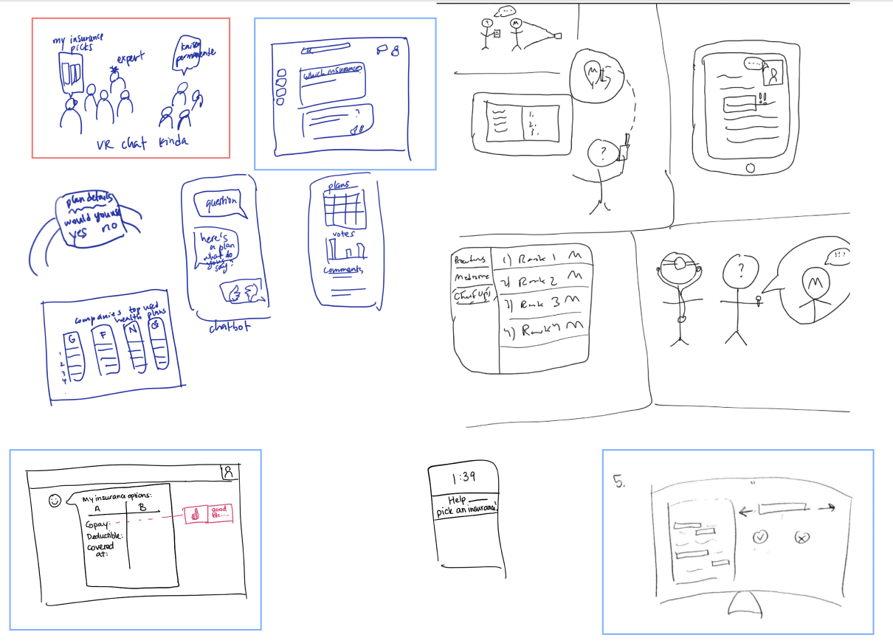
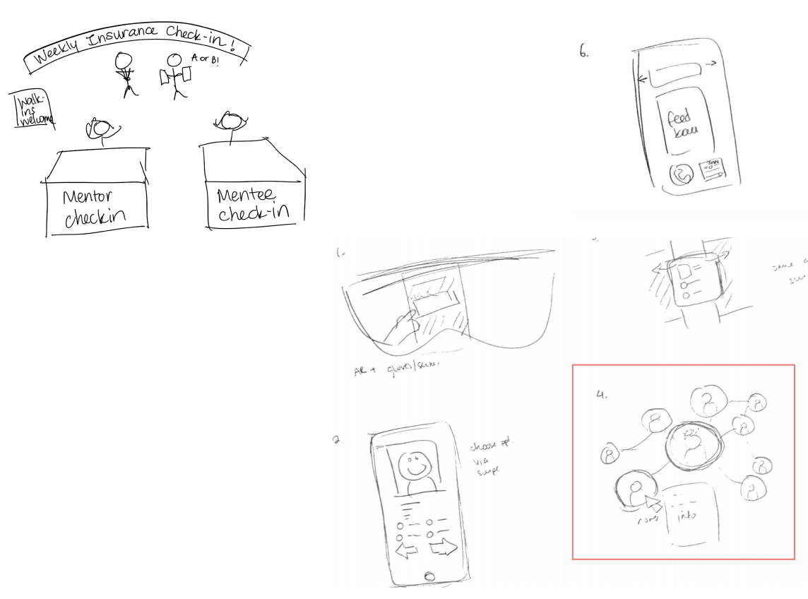
Sketch Board
Notes:
We started off with a few different stand alone ideas.
Long story short is that it resulted in two user experiences.

Slide 8
Sketch Board
Design1
Design2
Notes:
In the sketches outlined in light blue, we have one user experience and for sketches outlined in red, we have the other user experience.
And so naturally this led us to our design selection process.

Slide 9
Outline
✏️ Sketches
📌 Design Selection
📝 Task Storyboards
📐 Low-fi Prototype
🧪 Experiment
💡 Key Learnings
Appendix
Notes:
To do this, we reviewed notes from our past interviews and
focus mapped our major pain points
and then prioritized them based on our resources constraints.

Slide 10
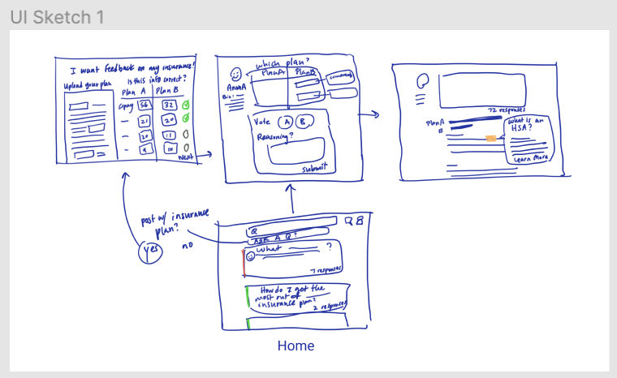
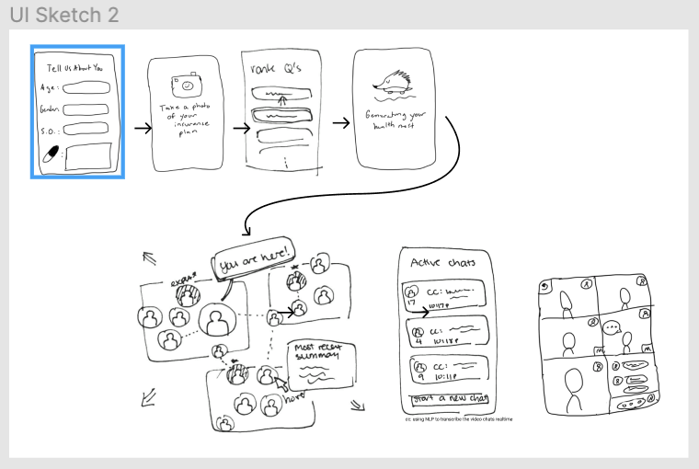
Design Selection
Notes:
We resulted in Sketch 1
And Sketch 2

Slide 11
Design Selection
Notes:
Let’s dive into sketch 1 here.

Slide 12
Design 1
✅
❌
- Computers
more accessible to low income.
- Post anonymity protects identity.
- Easy to process visualizations and type in-depth feedback.
- Too many questions,
not enough answers.
- Too many devices
needed to upload insurance plan (if paper).
Notes:
Pros
people don’t feel comfortable posting their insurance attached to their identity)
What’s the incentive for answering? Stack overflow perhaps

Slide 13
Design 2
✅
❌
- Video chat improved human connection and community feel.
- Network visualization was helpful.
- Easy photo onboarding and mobile access.
- Less intuitive to navigate and information overload.
- No direct path to feedback on your insurance.
- Required mentors to be online whenever mentees were.
Notes:
Pros
people don’t feel comfortable posting their insurance attached to their identity)
What’s the incentive for answering? Stack overflow perhaps

Slide 14
We picked Design 1
✅ Easiest to understand for all
tasks our users desired.
✅ Most feasible within time
frame and easier to test.
Notes:
V! - they all picked one they imagined from the beginning ...and also completely opposite from their
High ROI - don’t refry chicken - easier keeping simple

Slide 15
Outline
✏️ Sketches
📌 Design Selection
📝 Task Storyboards
📐 Low-fi Prototype
🧪 Experiment
💡 Key Learnings
Appendix
Notes:
Tasks and Selected Interface Design (3-4 slides)
3 Tasks
Storyboards for 3 tasks
Reasoning for selection (pros/cons for each)

Slide 16
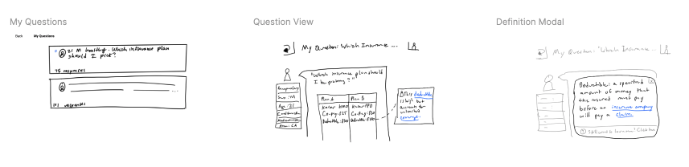
Simple Task Storyboard:
Find definition to term you don’t understand
Notes:
Tasks and Selected Interface Design (3-4 slides)
3 Tasks
Storyboards for 3 tasks
Reasoning for selection (pros/cons for each)
#3 taks = Simple
Given screen of your insurance plan -> key words highlighted -> click to define it (2-3)
ways to pick out terms?
-question marks
- always highlighted (blue underline like wikipedia)
- click on button to show key words
- highlight when you hover
#1 Moderate
Home page @ top submit a question -> ask question -> optionally add insurance plans to link? 0++ -> upload insurance plans -> verify information -> post
consider asking question at the end instead
#2 Complex
Home page w/ questions you haven’t looked at -> click one to view the question -> comment on specific aspects of insurance -> vote -> explain reasoning -> submit feedback

Slide 17
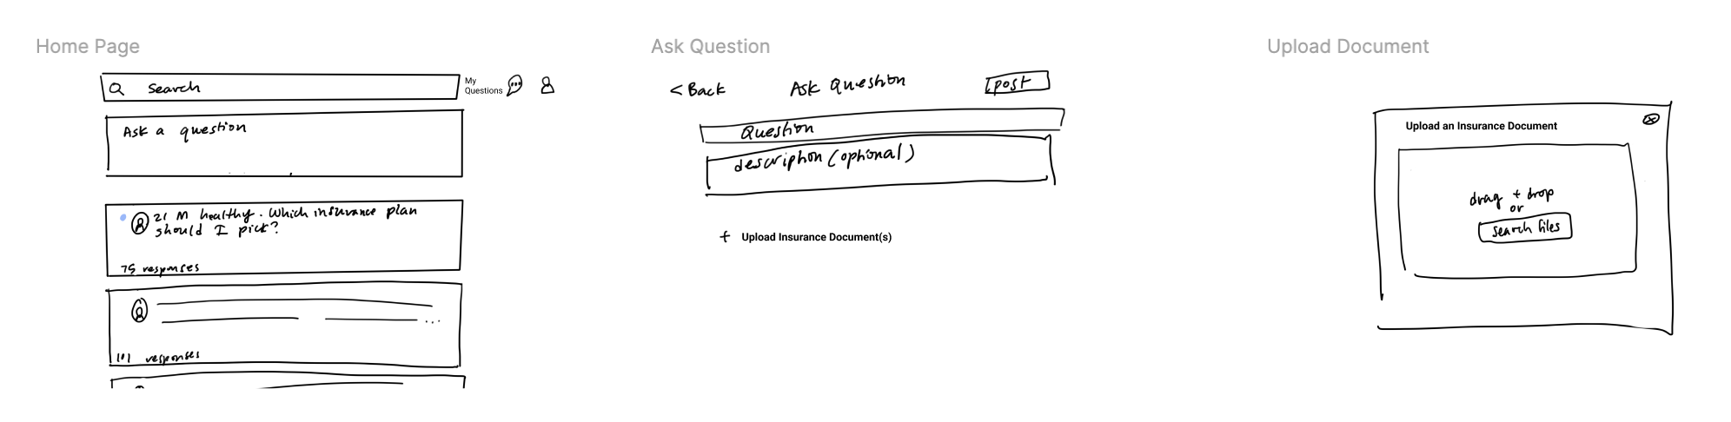
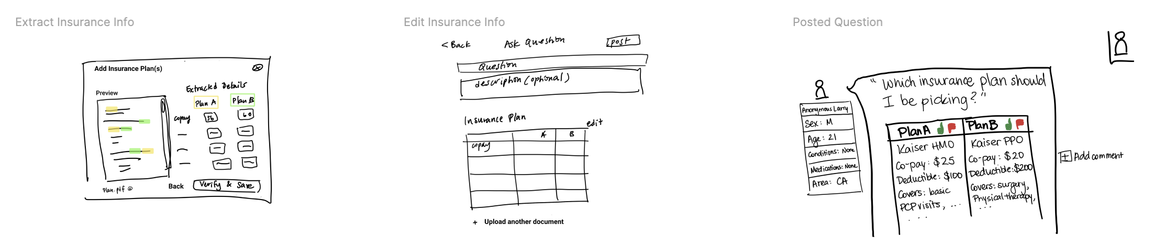
Moderate Task Storyboard:
Upload two insurance plans and post a question about them
Notes:
Tasks and Selected Interface Design (3-4 slides)
3 Tasks
Storyboards for 3 tasks
Reasoning for selection (pros/cons for each)
#3 taks = Simple
Given screen of your insurance plan -> key words highlighted -> click to define it (2-3)
ways to pick out terms?
-question marks
- always highlighted (blue underline like wikipedia)
- click on button to show key words
- highlight when you hover
#1 Moderate
Home page @ top submit a question -> ask question -> optionally add insurance plans to link? 0++ -> upload insurance plans -> verify information -> post
consider asking question at the end instead
#2 Complex
Home page w/ questions you haven’t looked at -> click one to view the question -> comment on specific aspects of insurance -> vote -> explain reasoning -> submit feedback

Slide 18
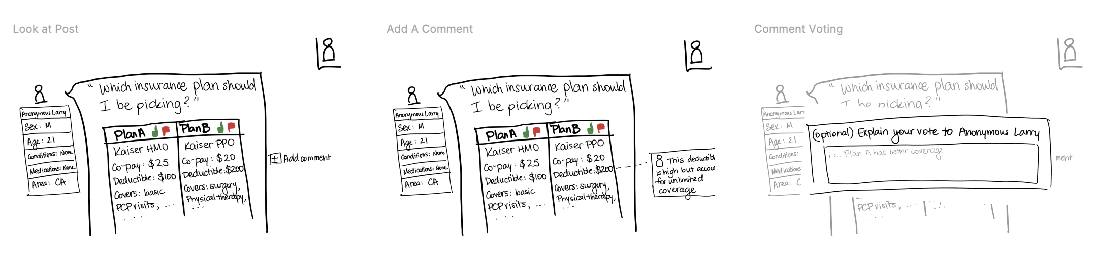
Complex Task Storyboard:
Navigate to question, comment, & vote on someone’s insurance plan
Notes:
Tasks and Selected Interface Design (3-4 slides)
3 Tasks
Storyboards for 3 tasks
Reasoning for selection (pros/cons for each)
#3 taks = Simple
Given screen of your insurance plan -> key words highlighted -> click to define it (2-3)
ways to pick out terms?
-question marks
- always highlighted (blue underline like wikipedia)
- click on button to show key words
- highlight when you hover
#1 Moderate
Home page @ top submit a question -> ask question -> optionally add insurance plans to link? 0++ -> upload insurance plans -> verify information -> post
consider asking question at the end instead
#2 Complex
Home page w/ questions you haven’t looked at -> click one to view the question -> comment on specific aspects of insurance -> vote -> explain reasoning -> submit feedback

Slide 19
Outline
✏️ Sketches
📌 Design Selection
📝 Task Storyboards
📐 Low-fi Prototype
🧪 Experiment
💡 Key Learnings
Appendix

Slide 20
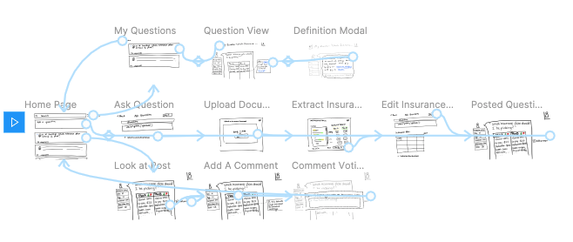
Prototype
Notes:
Prototype description, with images of each screen used by your tasks and a picture of the entire system (include in appendix)
https://www.figma.com/file/DSgazxvGULbbsE81VnX8qs/377E-Health-Insurance-Education?node-id=3%3A0

Slide 21
Simple Task Prototype:
Find definition to term you don’t understand
Notes:
Tasks and Selected Interface Design (3-4 slides)
3 Tasks
Storyboards for 3 tasks
Reasoning for selection (pros/cons for each)
#3 taks = Simple
Given screen of your insurance plan -> key words highlighted -> click to define it (2-3)
ways to pick out terms?
-question marks
- always highlighted (blue underline like wikipedia)
- click on button to show key words
- highlight when you hover
#1 Moderate
Home page @ top submit a question -> ask question -> optionally add insurance plans to link? 0++ -> upload insurance plans -> verify information -> post
consider asking question at the end instead
#2 Complex
Home page w/ questions you haven’t looked at -> click one to view the question -> comment on specific aspects of insurance -> vote -> explain reasoning -> submit feedback

Slide 22
Simple Task Prototype:
Find definition to term you don’t understand
Results:
Users ❤️ hyperlinks!
Notes:
Tasks and Selected Interface Design (3-4 slides)
3 Tasks
Storyboards for 3 tasks
Reasoning for selection (pros/cons for each)
#3 taks = Simple
Given screen of your insurance plan -> key words highlighted -> click to define it (2-3)
ways to pick out terms?
-question marks
- always highlighted (blue underline like wikipedia)
- click on button to show key words
- highlight when you hover
#1 Moderate
Home page @ top submit a question -> ask question -> optionally add insurance plans to link? 0++ -> upload insurance plans -> verify information -> post
consider asking question at the end instead
#2 Complex
Home page w/ questions you haven’t looked at -> click one to view the question -> comment on specific aspects of insurance -> vote -> explain reasoning -> submit feedback

Slide 23
Moderate Task Prototype:
Upload two insurance plans and post a question about them
Notes:
Tasks and Selected Interface Design (3-4 slides)
3 Tasks
Storyboards for 3 tasks
Reasoning for selection (pros/cons for each)
#3 taks = Simple
Given screen of your insurance plan -> key words highlighted -> click to define it (2-3)
ways to pick out terms?
-question marks
- always highlighted (blue underline like wikipedia)
- click on button to show key words
- highlight when you hover
#1 Moderate
Home page @ top submit a question -> ask question -> optionally add insurance plans to link? 0++ -> upload insurance plans -> verify information -> post
consider asking question at the end instead
#2 Complex
Home page w/ questions you haven’t looked at -> click one to view the question -> comment on specific aspects of insurance -> vote -> explain reasoning -> submit feedback

Slide 24
Moderate Task Prototype:
Upload two insurance plans and post a question about them
Results:
Too many plans 😐
Notes:
Difference in number of plans in one insurance document, leads to confusion on insurance document vs. insurance plan
Labelling is ambiguous / matrix
What if I don’t have a pdf of my insurance?
Tasks and Selected Interface Design (3-4 slides)
3 Tasks
Storyboards for 3 tasks
Reasoning for selection (pros/cons for each)
#3 taks = Simple
Given screen of your insurance plan -> key words highlighted -> click to define it (2-3)
ways to pick out terms?
-question marks
- always highlighted (blue underline like wikipedia)
- click on button to show key words
- highlight when you hover
#1 Moderate
Home page @ top submit a question -> ask question -> optionally add insurance plans to link? 0++ -> upload insurance plans -> verify information -> post
consider asking question at the end instead
#2 Complex
Home page w/ questions you haven’t looked at -> click one to view the question -> comment on specific aspects of insurance -> vote -> explain reasoning -> submit feedback

Slide 25
Complex Task Prototype:
Navigate to question, comment, & vote on someone’s insurance plan
Notes:
Tasks and Selected Interface Design (3-4 slides)
3 Tasks
Storyboards for 3 tasks
Reasoning for selection (pros/cons for each)
#3 taks = Simple
Given screen of your insurance plan -> key words highlighted -> click to define it (2-3)
ways to pick out terms?
-question marks
- always highlighted (blue underline like wikipedia)
- click on button to show key words
- highlight when you hover
#1 Moderate
Home page @ top submit a question -> ask question -> optionally add insurance plans to link? 0++ -> upload insurance plans -> verify information -> post
consider asking question at the end instead
#2 Complex
Home page w/ questions you haven’t looked at -> click one to view the question -> comment on specific aspects of insurance -> vote -> explain reasoning -> submit feedback

Slide 26
Complex Task Prototype:
Navigate to question, comment, & vote on someone’s insurance plan
Results:
1. Too much text 😫
Notes:
Freeform commentary is hard to parse, especially when it’s endless scrolling
Lack of trust and clarity on who should be the people to actually comment/who is able to vote What is their credibility and are their points relevant to me? Extreme users (serious condition), needs more qualified comparison on insurance plans
Tasks and Selected Interface Design (3-4 slides)
3 Tasks
Storyboards for 3 tasks
Reasoning for selection (pros/cons for each)
#3 taks = Simple
Given screen of your insurance plan -> key words highlighted -> click to define it (2-3)
ways to pick out terms?
-question marks
- always highlighted (blue underline like wikipedia)
- click on button to show key words
- highlight when you hover
#1 Moderate
Home page @ top submit a question -> ask question -> optionally add insurance plans to link? 0++ -> upload insurance plans -> verify information -> post
consider asking question at the end instead
#2 Complex
Home page w/ questions you haven’t looked at -> click one to view the question -> comment on specific aspects of insurance -> vote -> explain reasoning -> submit feedback

Slide 27
Complex Task Prototype:
Navigate to question, comment, & vote on someone’s insurance plan
Results:
2. Credibility of people commenting and voting was important, but missing.
Notes:
Freeform commentary is hard to parse, especially when it’s endless scrolling
Lack of trust and clarity on who should be the people to actually comment/who is able to vote What is their credibility and are their points relevant to me? Extreme users (serious condition), needs more qualified comparison on insurance plans
Tasks and Selected Interface Design (3-4 slides)
3 Tasks
Storyboards for 3 tasks
Reasoning for selection (pros/cons for each)
#3 taks = Simple
Given screen of your insurance plan -> key words highlighted -> click to define it (2-3)
ways to pick out terms?
-question marks
- always highlighted (blue underline like wikipedia)
- click on button to show key words
- highlight when you hover
#1 Moderate
Home page @ top submit a question -> ask question -> optionally add insurance plans to link? 0++ -> upload insurance plans -> verify information -> post
consider asking question at the end instead
#2 Complex
Home page w/ questions you haven’t looked at -> click one to view the question -> comment on specific aspects of insurance -> vote -> explain reasoning -> submit feedback

Slide 28
Outline
✏️ Sketches
📌 Design Selection
📝 Task Storyboards
📐 Low-fi Prototype
🧪 Experiment
💡 Key Learnings
Appendix

Slide 29
Experiment
Target: Young adults who want more information about their health insurance plan
A Boston-based medical student
A new-grad engineer in the Bay Area
A civil-engineering college senior taking classes remotely from home
A new-grad designer who started working remote
Varied levels of interaction with tech and healthcare system
Method:
Participants recruited via friends of friends and via email listservs
Consent form, Zoom meeting, Figma click through, Record via screensharing
Notes:
Difference: levels of familiarity with technology and level of interaction with healthcare system
Experiment (3-6 slides)
Method
Participants: demographics, how recruited/compensated
Tasks
Procedure (including environment & testing setup): Procedure: Zoom call and have the participant share screen and we record as they use the Figma prototype tool
Results
Key things you learned for your project going forward

Slide 30



Experiment
Target: Young adults who want more information about their health insurance plan
A Boston-based medical student
A new-grad engineer in the Bay Area
A civil-engineering college senior taking classes remotely from home
A new-grad designer who started working remote
Varied levels of interaction with tech and healthcare system
Method:
Participants recruited via friends of friends and via email listservs
Consent form, Zoom meeting, Figma click through, Record via screensharing
Notes:
Difference: levels of familiarity with technology and level of interaction with healthcare system
Experiment (3-6 slides)
Method
Participants: demographics, how recruited/compensated
Tasks
Procedure (including environment & testing setup): Procedure: Zoom call and have the participant share screen and we record as they use the Figma prototype tool
Results
Key things you learned for your project going forward

Slide 31
Experiment
Target: Young adults who want more information about their health insurance plan
A Boston-based medical student
A new-grad engineer in the Bay Area
A civil-engineering college senior taking classes remotely from home
A new-grad designer who started working remote
Varied levels of interaction with tech and healthcare system
Note:
Varied levels of interaction with tech and healthcare system
Notes:
Difference: levels of familiarity with technology and level of interaction with healthcare system
Experiment (3-6 slides)
Method
Participants: demographics, how recruited/compensated
Tasks
Procedure (including environment & testing setup): Procedure: Zoom call and have the participant share screen and we record as they use the Figma prototype tool
Results
Key things you learned for your project going forward

Slide 32
Outline
✏️ Sketches
📌 Design Selection
📝 Task Storyboards
📐 Low-fi Prototype
🧪 Experiment
💡 Key Learnings
Appendix

Slide 33
Key Learnings
People want help with healthcare definitions
People want to participate in discussion, but not be overwhelmed by text and irrelevant comments
People want to know the credibility of the commenters and voters as it relates to the user’s identity
Notes:
(In particular, health insurance education is a leading barrier to better healthcare education)
We tested these parts of our past interations but we moved forward on this

Slide 34
Thank you! Any questions?

Slide 35
Appendix

Slide 36
Experiment Script and Note template
https://docs.google.com/document/d/1pyegSJMAwFgY_4XJ5TcpDyCvbxWiqj1gk5zr67sEOgc/edit?usp=sharing
https://docs.google.com/document/d/1eSigHOAgQs8Mm9mD9vo23st_EgLaDQearWW--F_FLAg/edit
Experiment Notes
https://docs.google.com/document/d/19b3RFVPrfbhG708tbZHvWg_v5kBvMiuNDwQ9qi3aNds/edit?usp=sharing
https://docs.google.com/document/d/1p7obbfPe5wI_7RE4BKBknbo-jn6VQYBbZ1_yRGpIhnc/edit?usp=sharing
https://docs.google.com/document/d/1Nc-y3G2DnUifFaje0yFSNcm5Oivk07dD8rwQT-VFJdU/edit?usp=sharing
https://docs.google.com/document/d/1fpld5OP1tw2_BtiW_PbKkHPeLmSbBdn1F3kiEa0fyQE/edit?usp=sharing
https://docs.google.com/document/d/1oYK3lmuji4lyx7rhzKCrRn5eTFVsd9lfRLlqh119YgA/edit?usp=sharing
Figma link with all of our work
https://www.figma.com/file/DSgazxvGULbbsE81VnX8qs/377E-Health-Insurance-Education?node-id=3%3A0
Insights document with summarized problems and suggested solutions
https://docs.google.com/document/d/1hbwlAtNbP62H6nrRfQPhy6NWwt-LoHdF68uDNBUky34/edit?usp=sharing

Slide 37
Please note that our team name, Larry the Porcupine, was not chosen in reference to Porcupine, Cheyenne Chief and Medicine Man.

Slide 38
Sketches
Notes:
Maybe label these? Red and blue ideas as main ones
Explored ideas like virtual reality for advice, network graphs to show others in your health insurance network, tinder for health insurance plans

Slide 39
Design Storyboard 1: Reddit for Health Insurance
Notes:
Sketches (images w/ caption) (1 slide showing variety)
Overview image of the 15-20 sketches you made (include all in appendix)
Top 2 designs storyboarded in more detail and the reasoning for choosing these

Slide 40
Design Storyboard 1: Reddit for Health Insurance
+
-
Computer-based platform can be more accessible to low-income YAs
Anonymity- can post insurance without attaching their identity
Ability to type and save in-depth feedback
Potential disproportionate number of questions and fewer answers
Unclear explicit incentive for answering
Might require multiple devices to upload paper insurance plan
Notes:
Sketches (images w/ caption) (1 slide showing variety)
Overview image of the 15-20 sketches you made (include all in appendix)
Top 2 designs storyboarded in more detail and the reasoning for choosing these

Slide 41
Design Storyboard 2: Network Map with Group Calls
Notes:
Sketches (images w/ caption) (1 slide showing variety)
Overview image of the 15-20 sketches you made (include all in appendix)
Top 2 designs storyboarded in more detail and the reasoning for choosing these

Slide 42
Design Storyboard 2: Network Map with Group Calls
+
-
Mobile platform is convenient to access
Interactive, more human connection w/ video chat
Visualizing your network is helpful/uses AI
Quick onboarding with photo options
Community-based concept fosters ongoing conversations
May be less intuitive to navigate and possible information overload
Less direct way to get feedback on your insurance
Requires mentor to be online whenever mentees are
Notes:
Sketches (images w/ caption) (1 slide showing variety)
Overview image of the 15-20 sketches you made (include all in appendix)
Top 2 designs storyboarded in more detail and the reasoning for choosing these

Slide 43
What We Picked!
We Picked Design Prototype 1
Easier to understand information architecture while accomplishing all the tasks/capabilities we need to address
More feasible within time frame, easier to test
Likely more accessible for YAs
Notes:
Maybe label these? Red and blue ideas as main ones

Slide 44
Experiment Participants
Boston-based medical student
New-grad engineer in Bay Area
A variety of young adults who want more information about their health insurance plan
Key difference: levels of familiarity with technology and interaction with healthcare system
Civil Engineering remote college senior
New-grad designer who started working remote
College student with specific healthcare needs

Slide 45
Procedure
Notes:
Experiment (3-6 slides)
Method
Participants: demographics, how recruited/compensated
Tasks
Procedure (including environment & testing setup): Procedure: Zoom call and have the participant share screen and we record as they use the Figma prototype tool
Results
Key things you learned for your project going forward

Slide 46
Prototype description
Notes:
Prototype description, with images of each screen used by your tasks and a picture of the entire system (include in appendix)
https://www.figma.com/file/DSgazxvGULbbsE81VnX8qs/377E-Health-Insurance-Education?node-id=3%3A0

Slide 47

Simple task: You see a response to one of your questions that has a term you aren’t sure what it means, can you find a definition for it?
Finding & Results:
People loved the hyperlinks
Excited to have a place to find out answers to “dumb questions”
Notes:
Tasks and Selected Interface Design (3-4 slides)
3 Tasks
Storyboards for 3 tasks
Reasoning for selection (pros/cons for each)

Slide 48
Medium task: Upload the two insurance plans you’re choosing between and post a question about them
Findings & Results:
Confusion on where the two insurance plans came from (“What if I have a question on my current plan?”)
Confused by the extraction page
“What if I don’t have a PDF of my insurance plan?”
Users need an alternative if they don’t have a pdf of insurance
Notes:
Tasks and Selected Interface Design (3-4 slides)
3 Tasks
Storyboards for 3 tasks
Reasoning for selection (pros/cons for each)

Slide 49
Complex task: Can you go to another user’s post, comment on it and vote on a plan?
Findings & Results:
Users don’t want unstructured feedback on their plan because freeform commentary is hard to parse, especially when it’s endless scrolling
Users are unsure as to who is commenting / voting on their plans and why they are credible
Notes:
Tasks and Selected Interface Design (3-4 slides)
3 Tasks
Storyboards for 3 tasks
Reasoning for selection (pros/cons for each)

Slide 50
Results and Brainstormed Solutions
Results
Solutions
Users need to be able to upload any number (0 - 2+) of plans and ask questions
Users need an alternative if don’t have a pdf of insurance (“what if I don’t have a PDF of my insurance plan?”)
Users don’t want unstructured feedback on their plan because freeform commentary is hard to parse, especially when it’s endless scrolling
Users need to know who is commenting / voting and why they are credible
Make the “write a question” screen flexible to allow for any number of plans
Link to an insurance provider so only need to input policy number or allow for manual typing in of values
Group comments by similarity, add ability to filter based on commenter’s demographics, health status, health insurance, etc.
Add moderators to page for fact-checking, allow people to pick who they want to review, recommend people to comment who are similar, summarize demographics of reviewers
Notes:
Experiment (3-6 slides)
Method
Participants: demographics, how recruited/compensated
Tasks
Procedure (including environment & testing setup):
Results
Key things you learned for your project going forward

Slide 51
Simple Task - find the definition of a term

Slide 52
Medium Task - Upload two insurance plans and post a question about them

Slide 53
Hard Task - Vote and comment on an insurance plan

